Slide 1
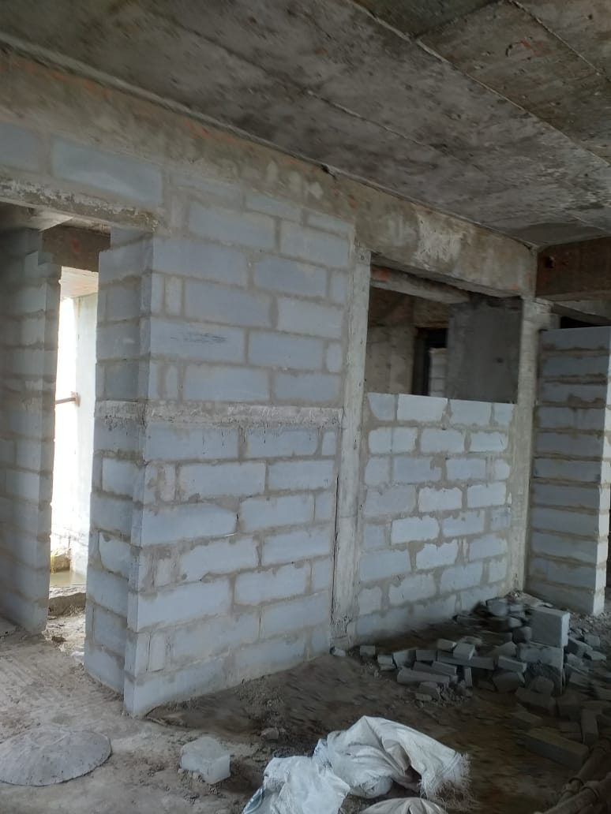
Brick works is in progress upto 22nd floor

Slide 2
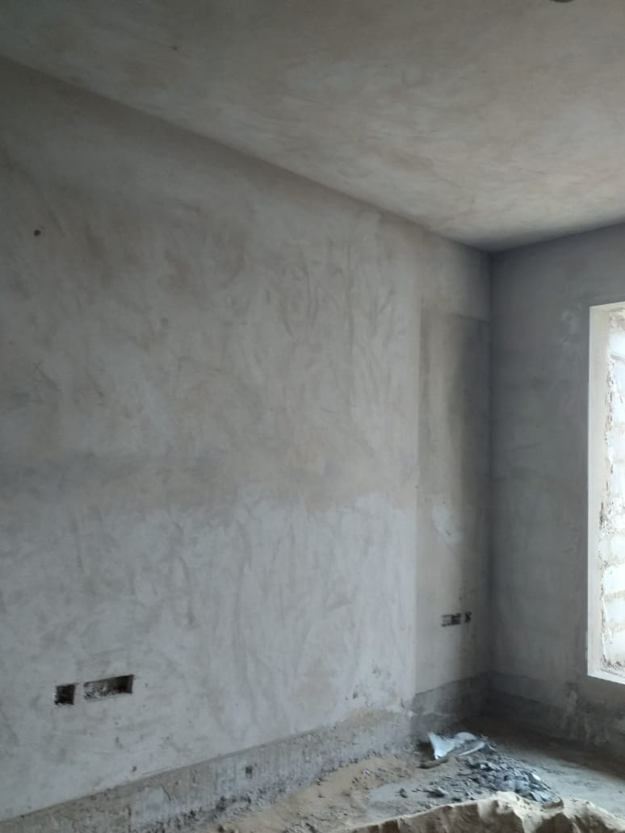
Plaster work is in progress upto 12th floor

Slide 3
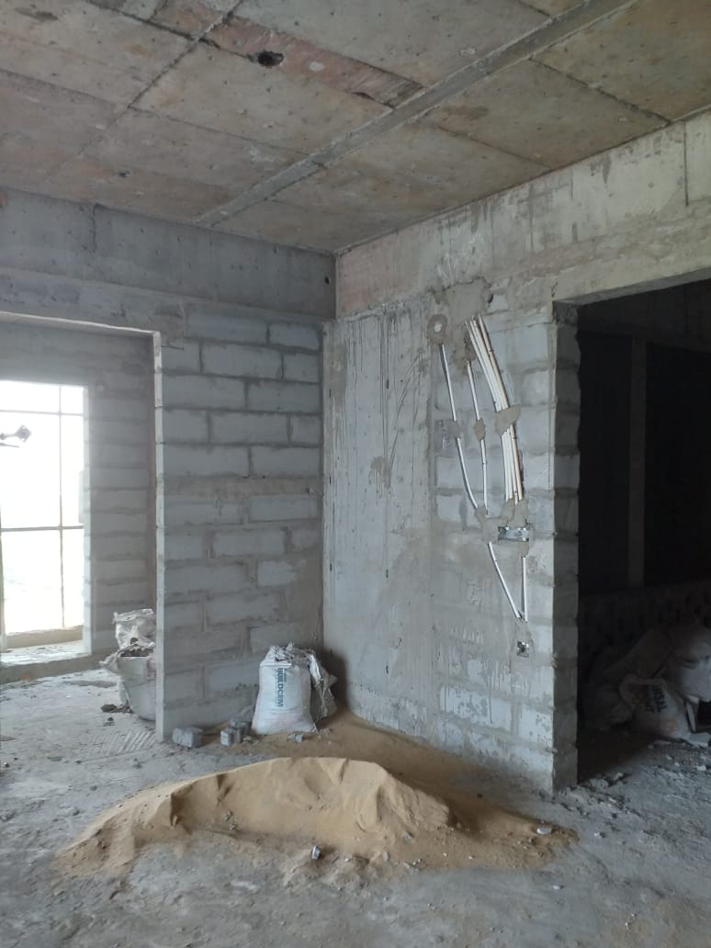
Electrical works is in progress

Slide 4
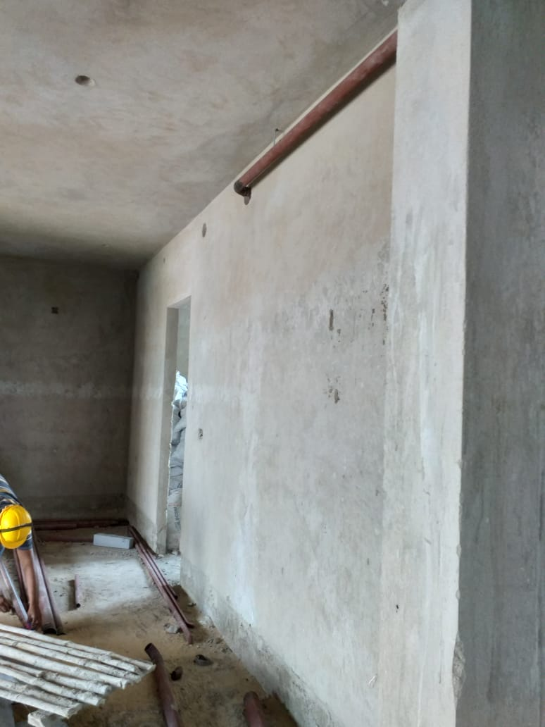
Fire Fighting works is in progress

Slide 5
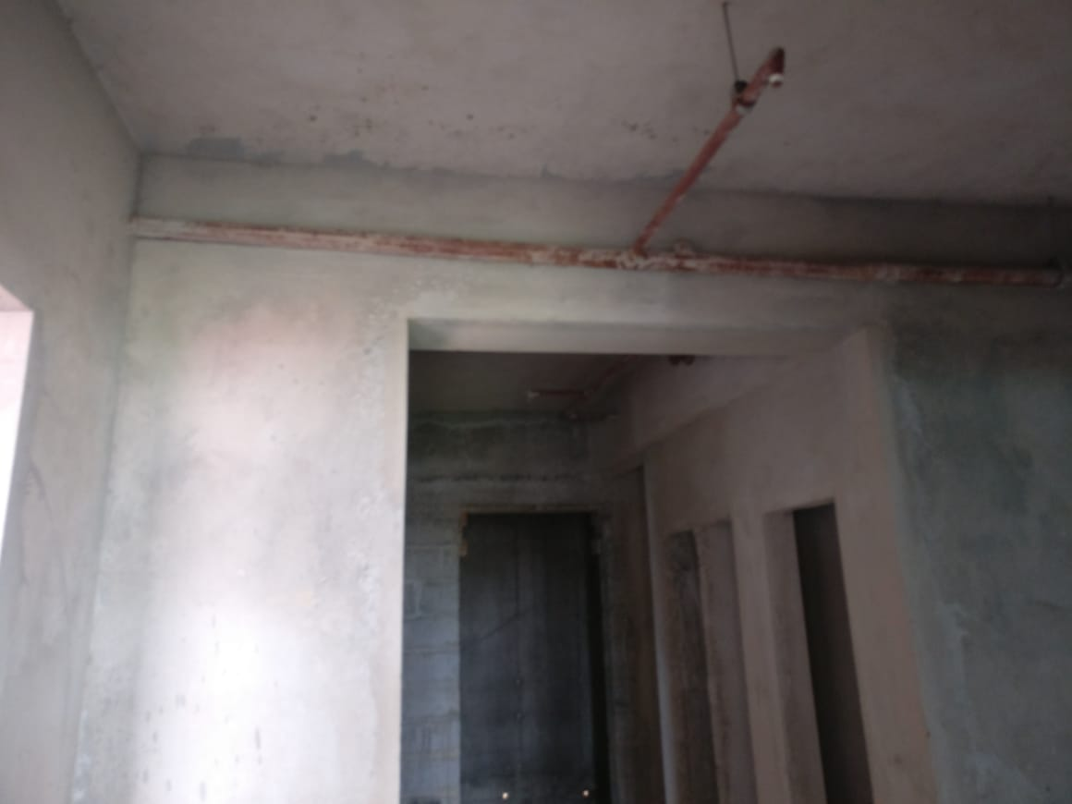
Fire Fighting works is in progress

Slide 6
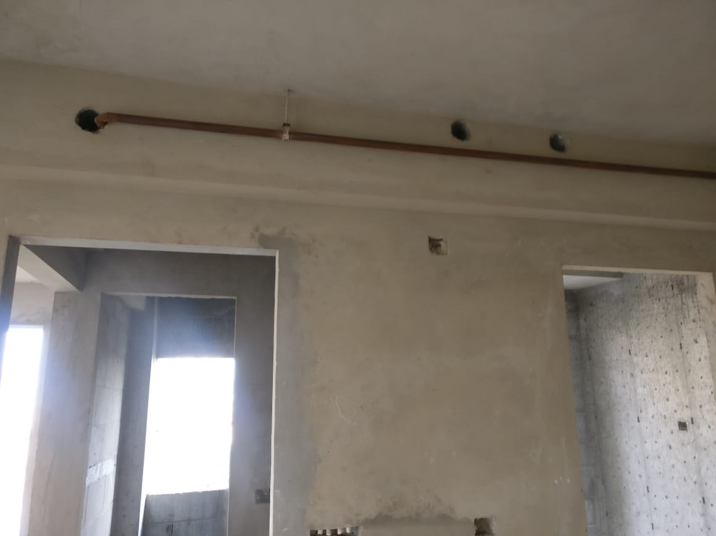
Fire Fighting works is in progress

Slide 7
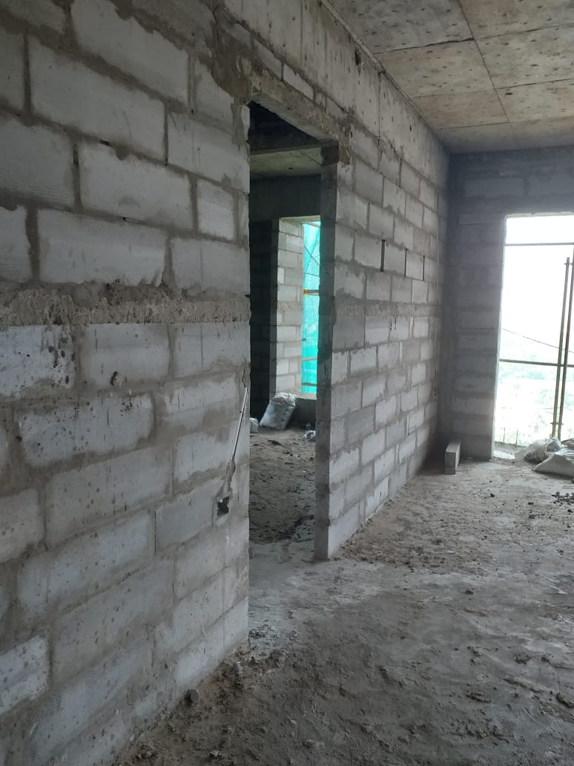
Brick works is in progress

Slide 8
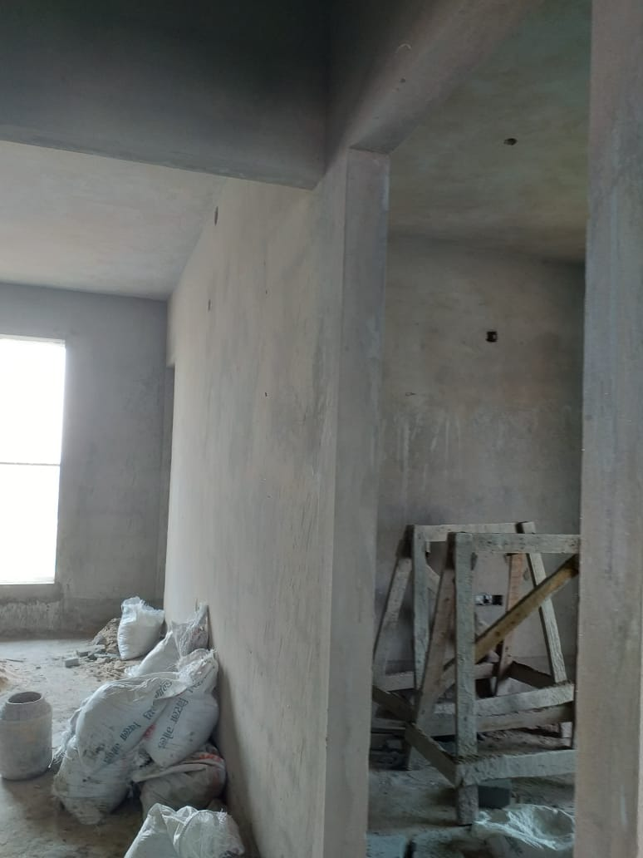
Plaster works is in progress

Slide 9
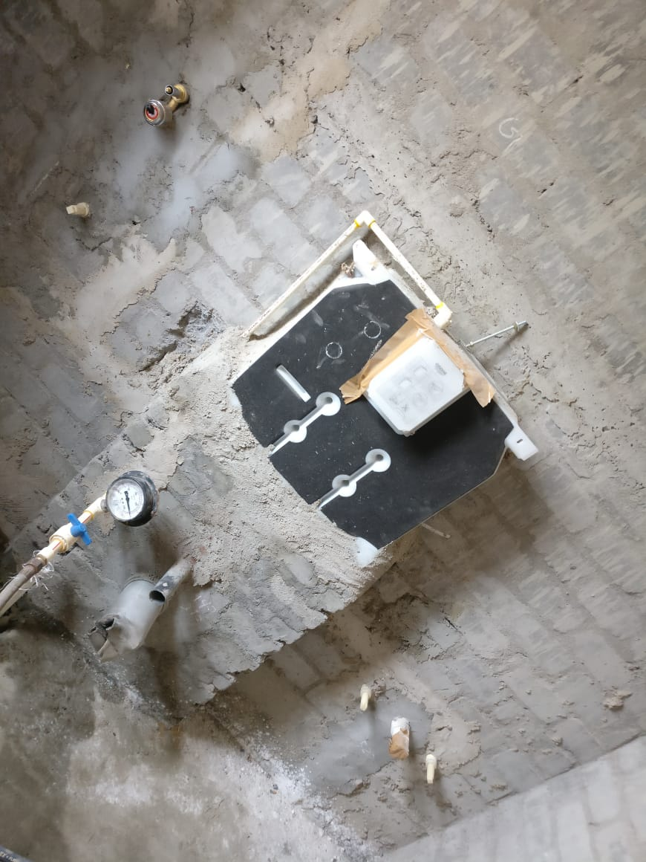
Plumbing works is in progress

Slide 10
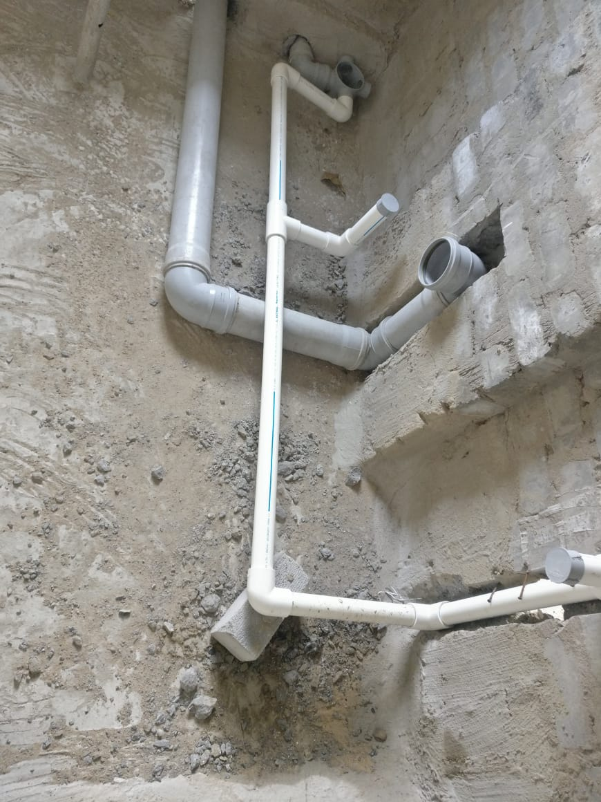
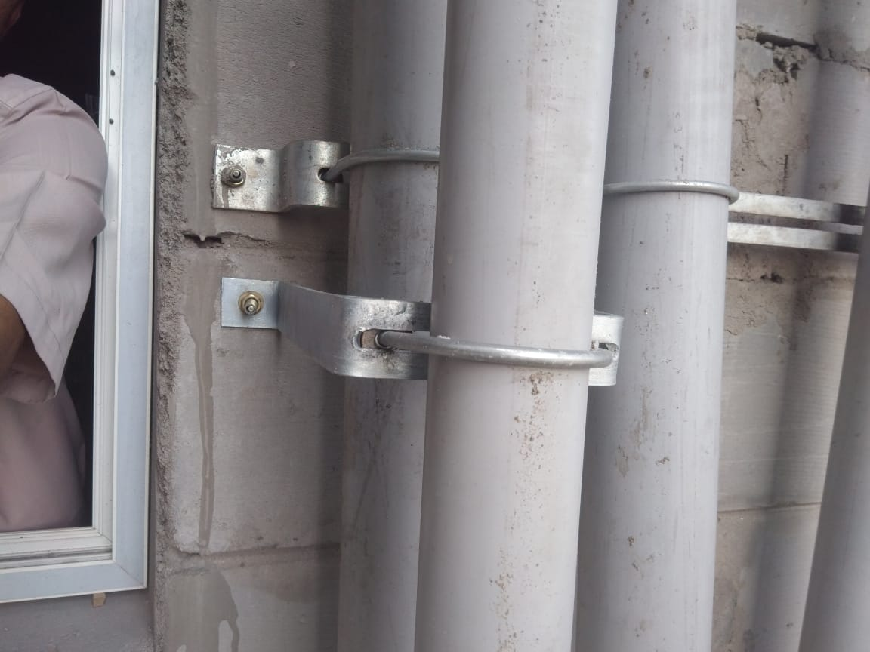
Plumbing works is in progress

Slide 11
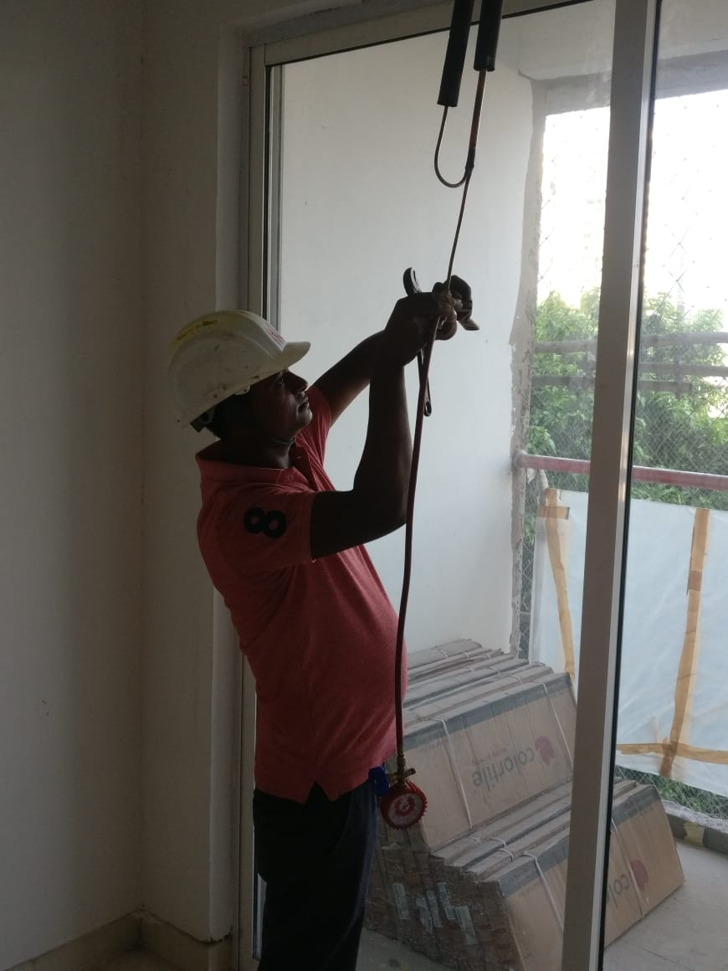
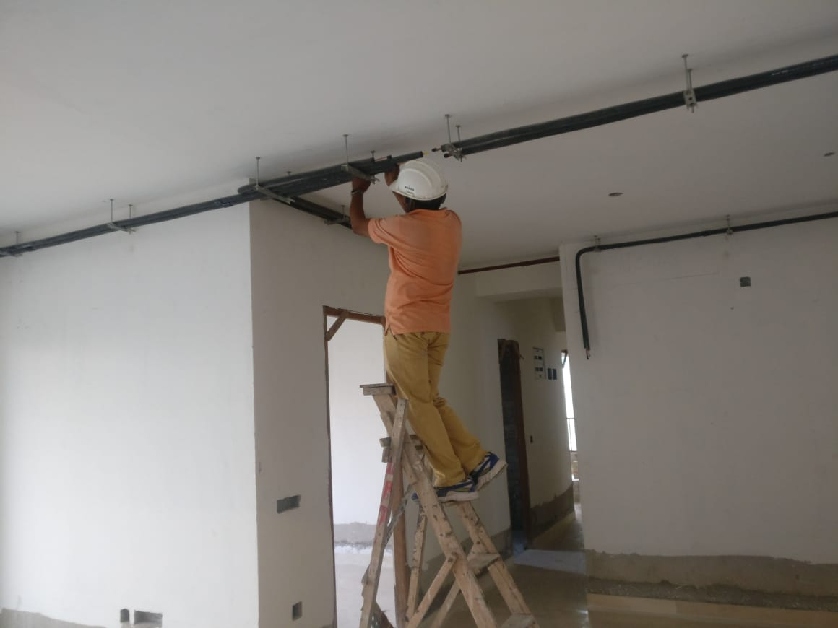
HVAC work is in progress at 2nd Floor

Slide 12
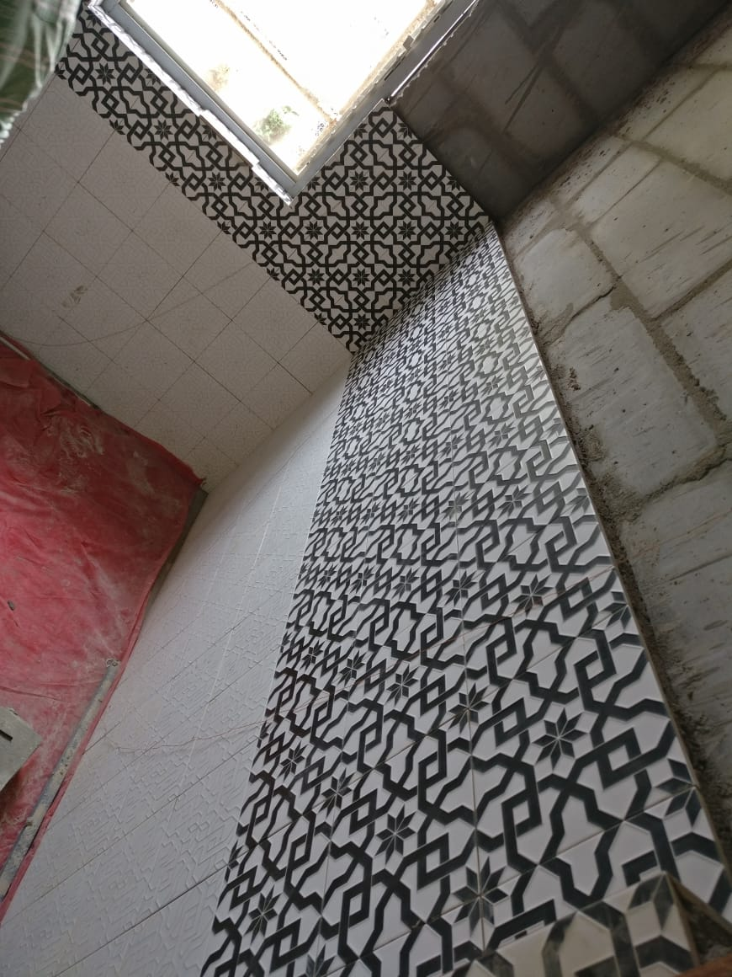
Tiling work is in progress at 2nd Floor

